Slide 1
Diagnosis Covid-19 System

Slide 2
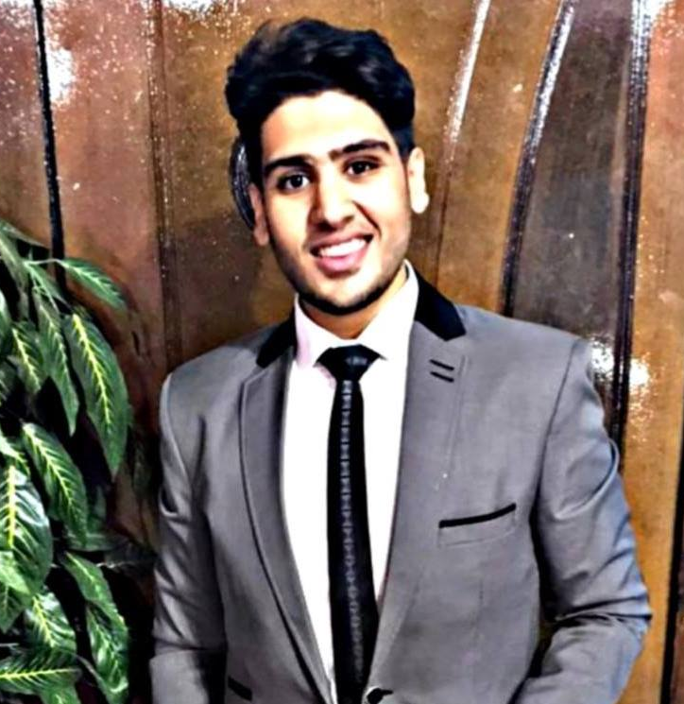

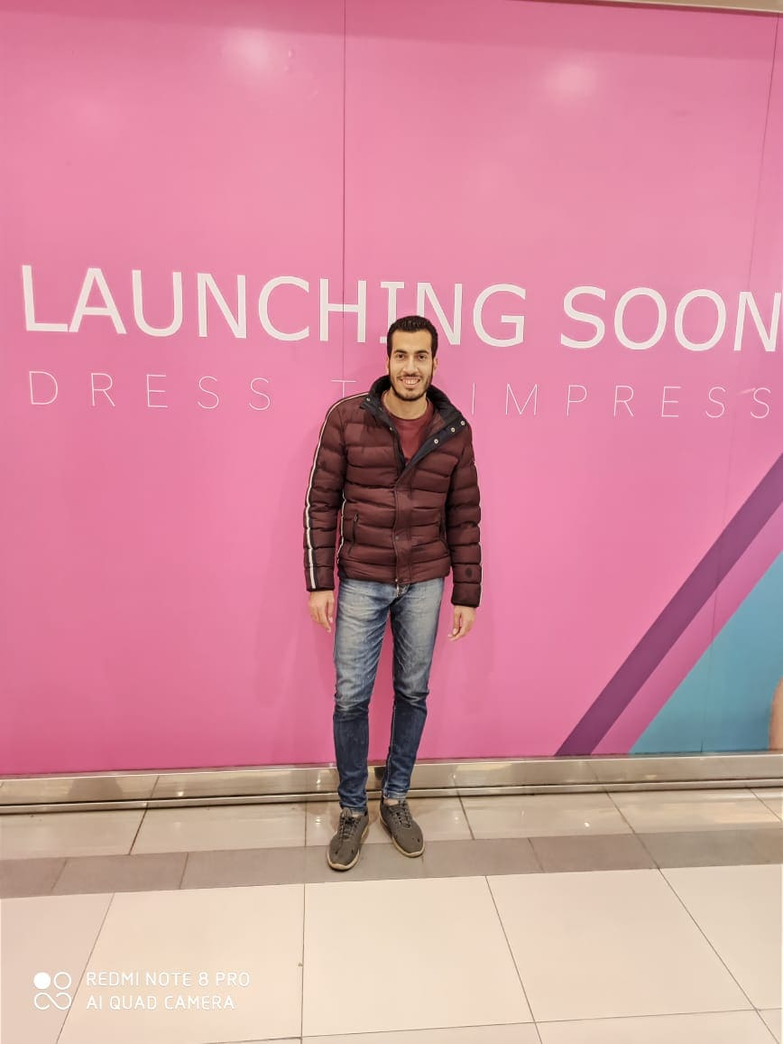
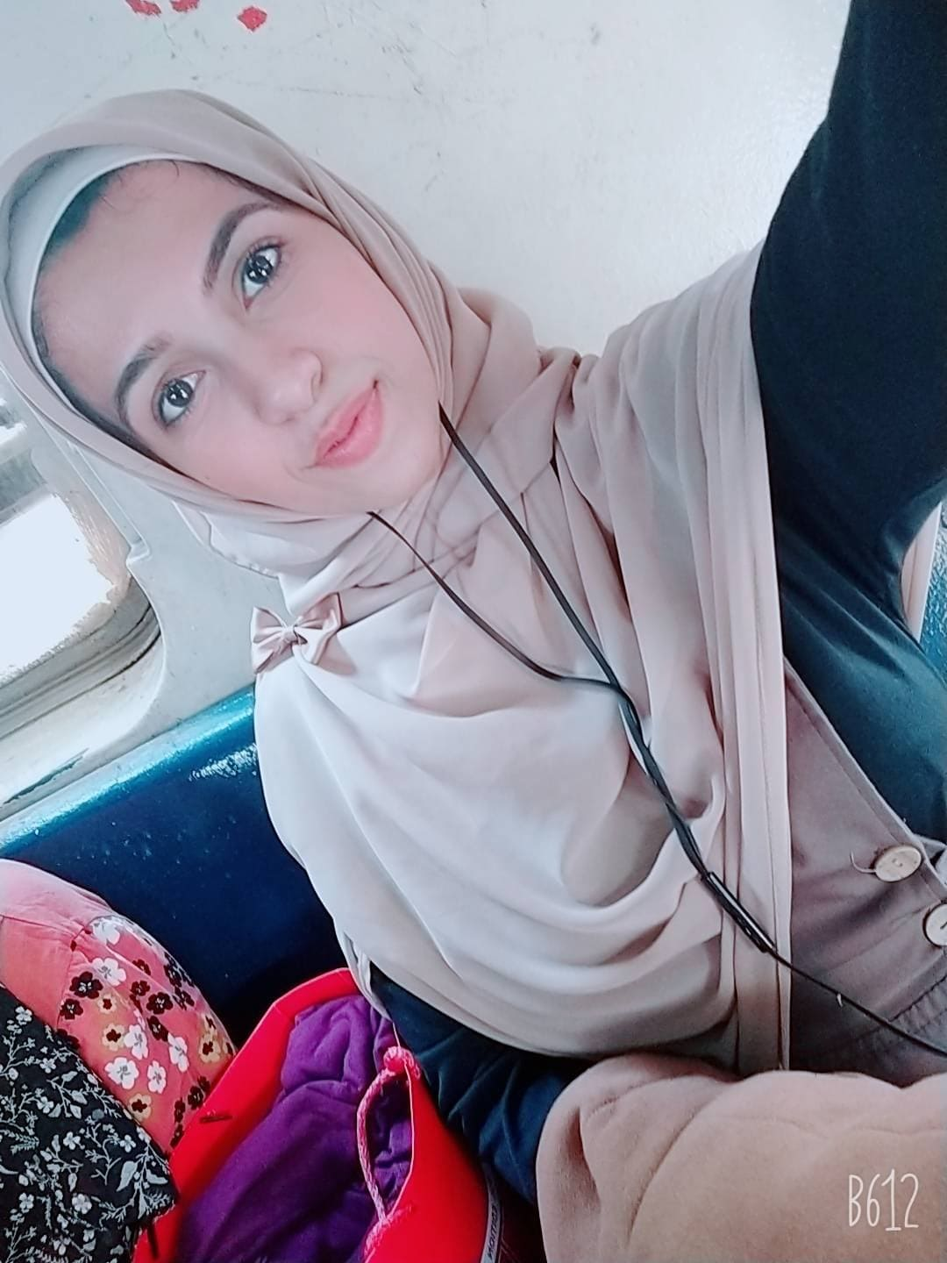

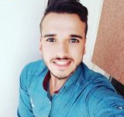
Our Team
Anas Rafat Mansour
Youssef Ashraf Salah
Ahmed Nabil Mahmoud
Islam Elsayed Abdelwahab
Omnia alwy abbas
Sara Habib Samir
Under Supervision of /Dr. Mohamed Taha

Slide 3
Table Of Contents
02
01
03
About Covid-19
Problems which inspired us to make this project.
System structure
04
05
Problems that we faced
System Development

Slide 4
Introduction
Covid-19 is an ambiguous disease which threat all the world so in our system we tried to diagnoses Covid-19 in easy way

Slide 5
01
About Covid-19

Slide 6
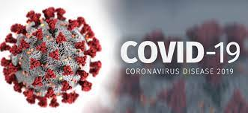
What is Covid-19 ?
Coronavirus disease 2019 (COVID-19( is new strain of coronavirus which called severe acute respiratory syndrome coronavirus 2 (SARS-CoV-2).
It is a group of viruses that can cause disease in both animals and humans.

Slide 7
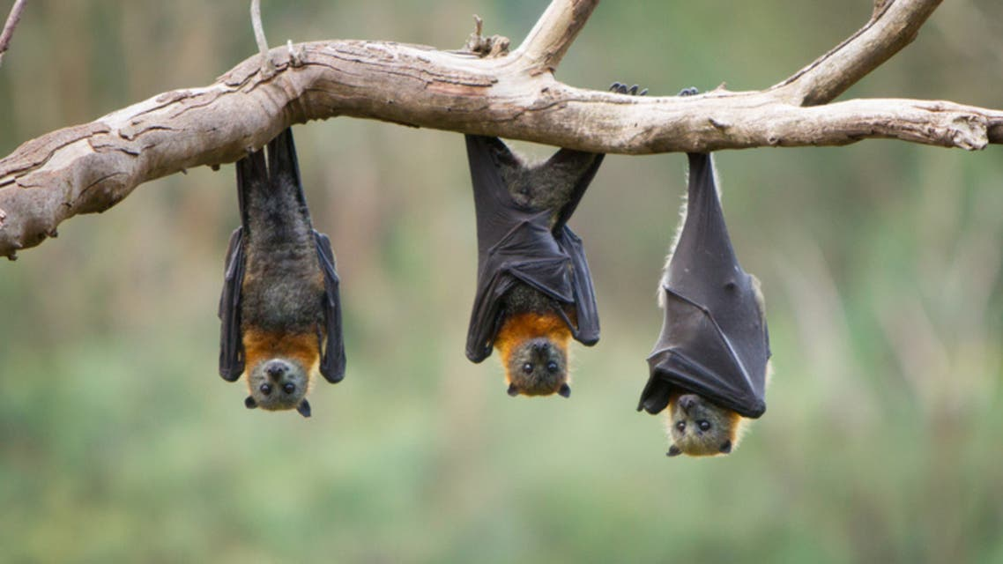
What caused coronavirus?
Coronaviruses are common in certain species of animals, such as cattle and camels.
Although the transmission of coronaviruses from animals to humans is rare, this new strain likely came from bats

Slide 8
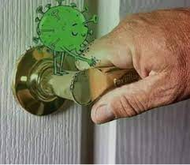
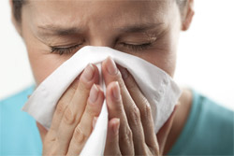
How it spreads
When people with COVID-19 breathe out or cough, they expel tiny droplets that contain the virus. These droplets can enter the mouth or nose of someone without the virus, causing an infection to occur.
Someone infected with the Corona virus can touch any surface and leave the virus on it for a period of time and then anyone else can touch that surface and catch the virus

Slide 9
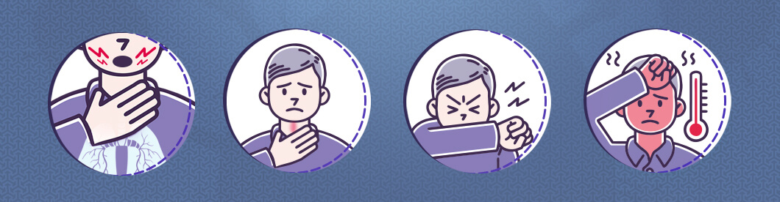
Virus Symptoms
Most common
Less common
serious
Fever
Dry cough
tridness
Aches and pains
Sore throat
Diarrhoea
Conjunctivities
Headache
Loss of teste or smell
A rash on skin
Difficulty breathing
Chest pain
loss of speech or movement

Slide 10
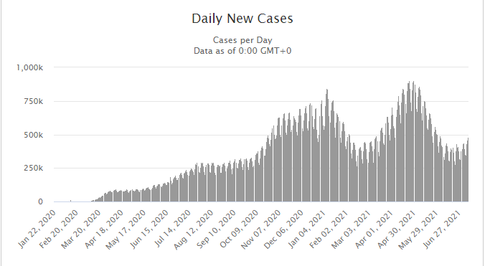
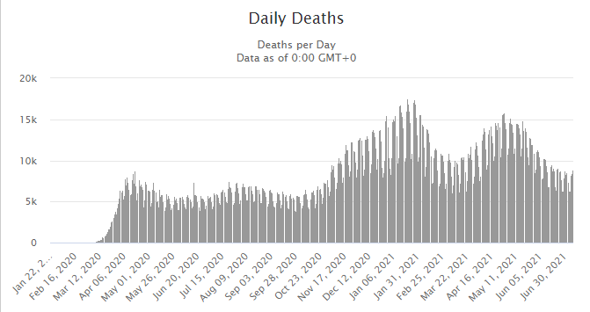
Statistic of Virus infection rate over time

Slide 11
02
Problems which inspired us to make this project.

Slide 12
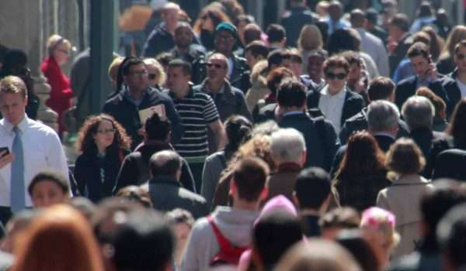
Problems which inspired us to make this project
Increase rate of infection by Covid-19 due to overcrowdings.

Slide 13
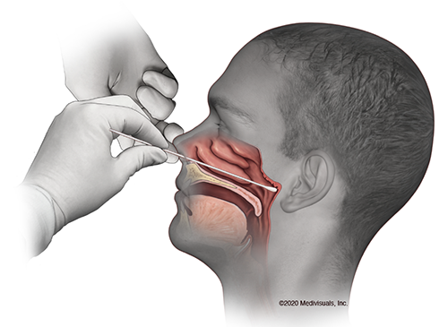
Problems which inspired us to make this project
Increase the price of nasal swab of covid 19 test.

Slide 14
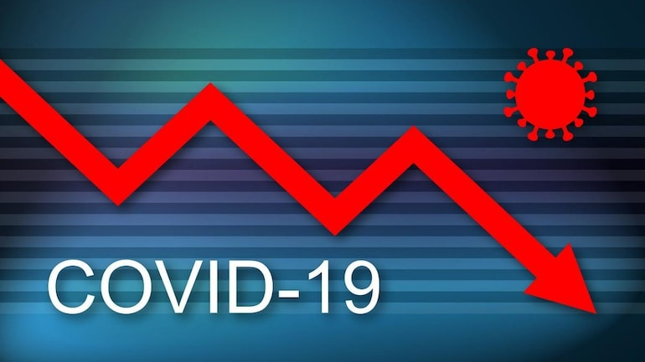
Problems which inspired us to make this project
Excessive efforts and time loss and money for the diagnosis.

Slide 15
03
System Structure

Slide 16
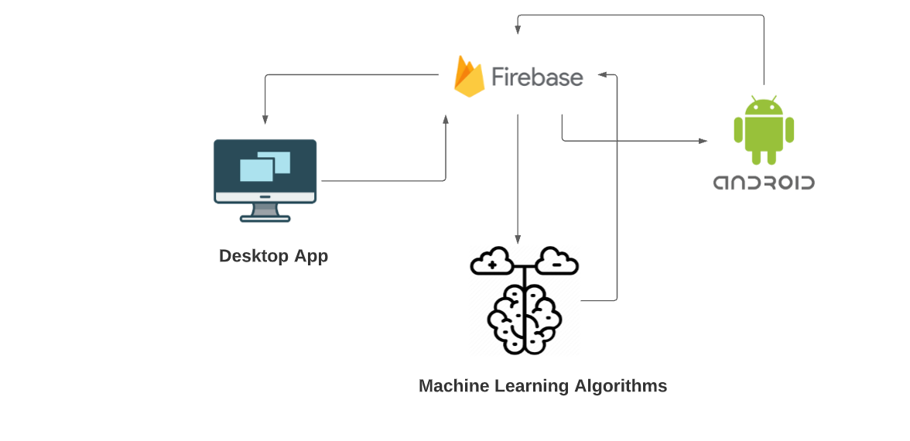
System Structure

Slide 17
Mobile Application

Slide 18
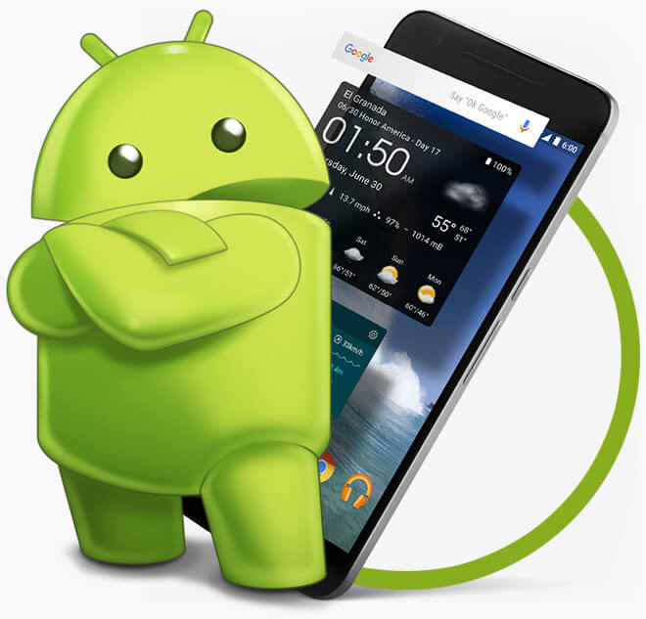
Mobile application
To Make the Mobile application, We used Android studio
Our Mobile Application responsible for:
Enter Patient Data
Receive the result and doctor's review

Slide 19
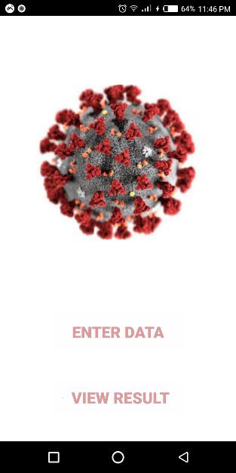
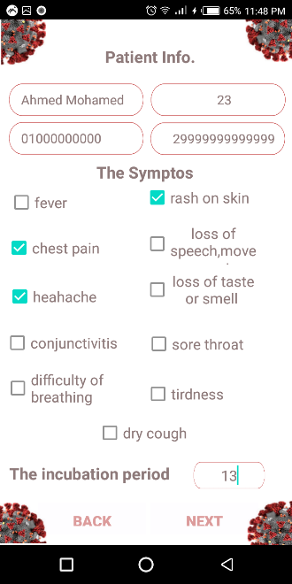
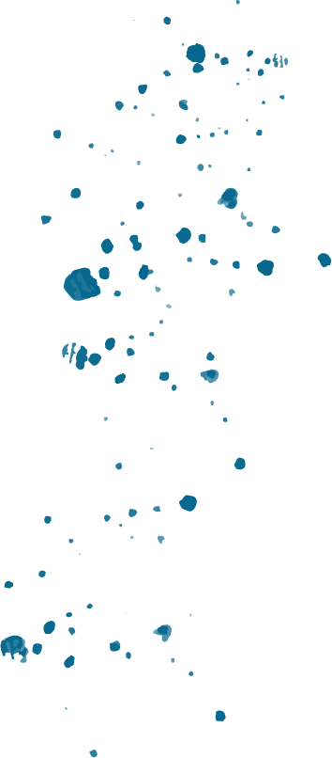
How patients apply to mobile application?

Slide 20
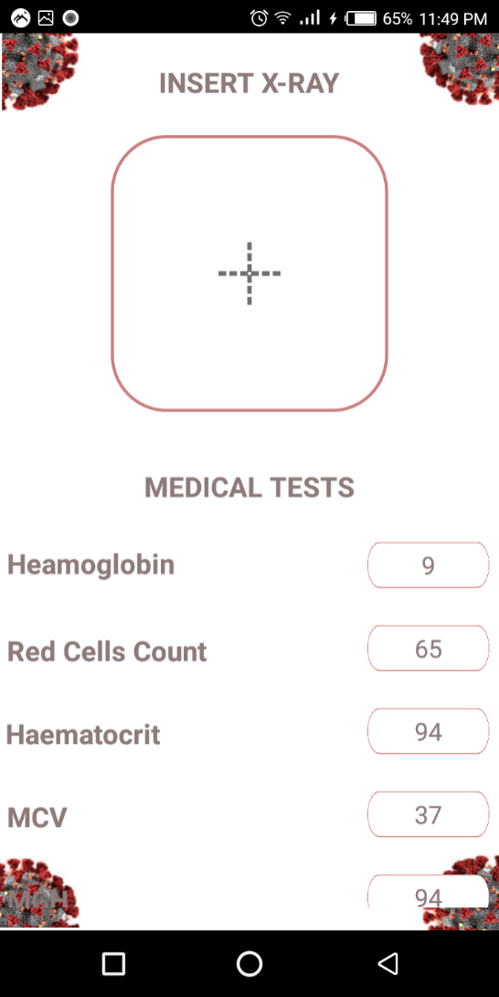
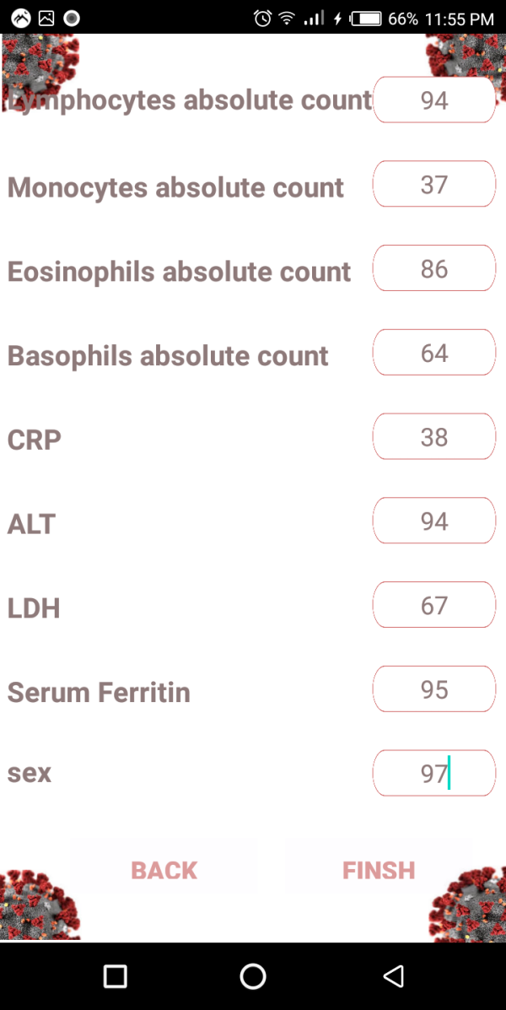
How patients apply to mobile application?

Slide 21
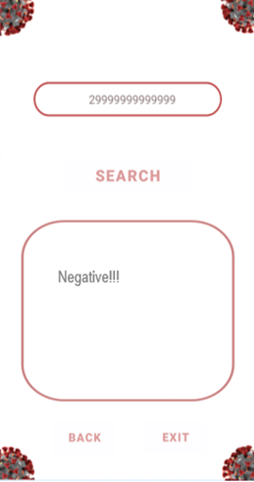
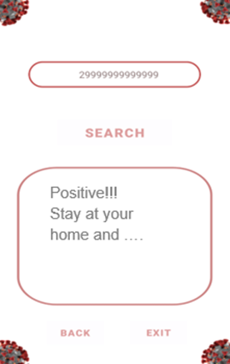
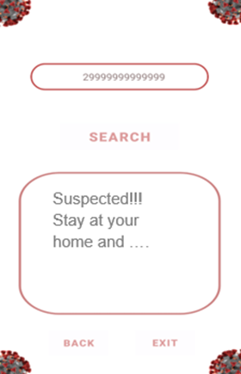
How patients apply to mobile application?

Slide 22
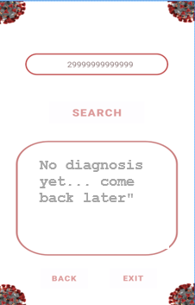
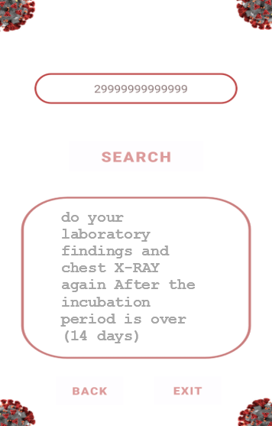
How patients apply to mobile application?

Slide 23
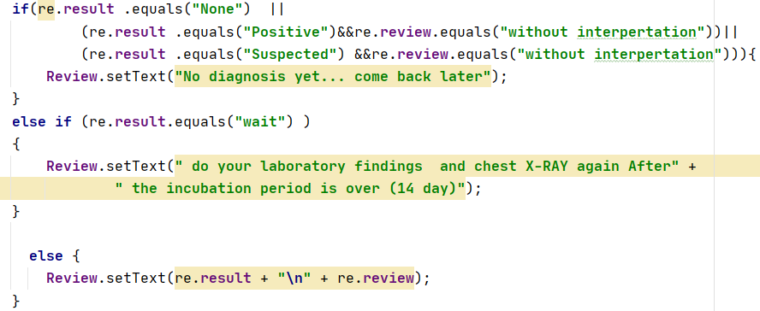
Mobile Application

Slide 24
Create Firebase

Slide 25
Firebase
Firebase Realtime
Storage
Realtime database ,store all information ,laboratory Finding and path of image (Chest x-ray) .
database Upload Chest X-Ray

Slide 26
Connect Mobile application with Firebase

Slide 27
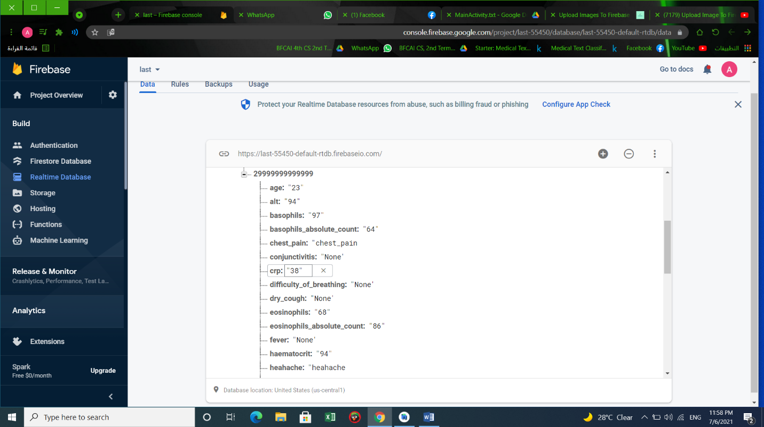
Upload patient data from mobile App. To Firebase Realtime

Slide 28
Deep Learning Model

Slide 29
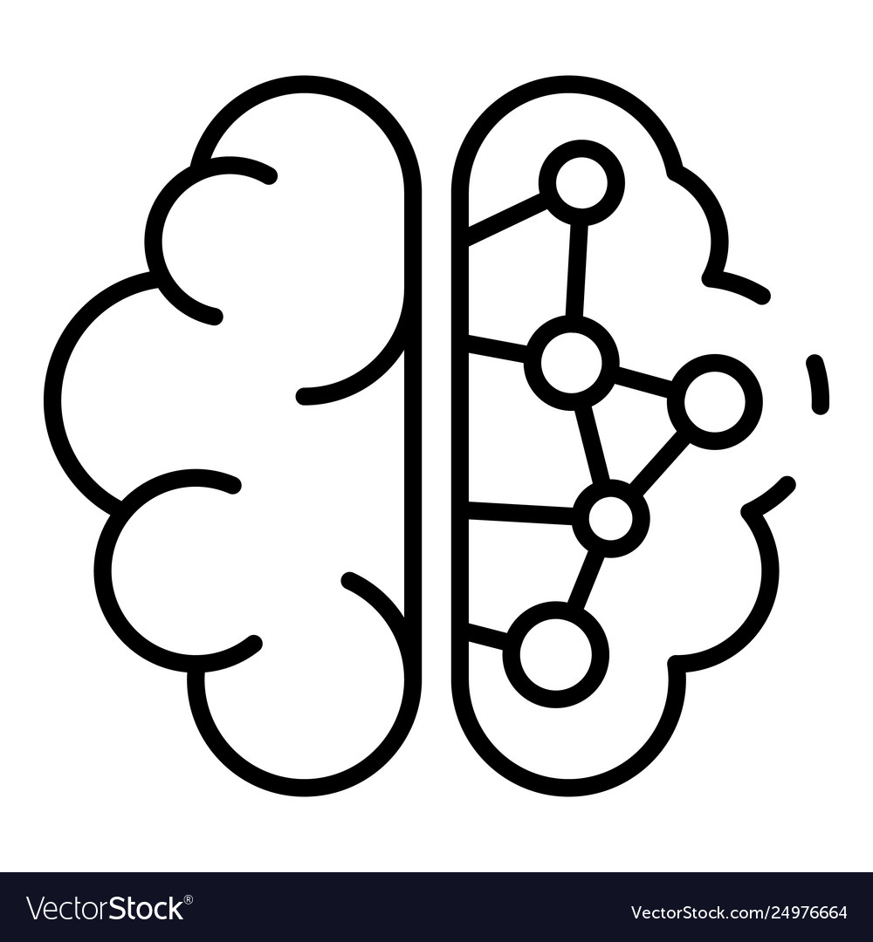
Deep Learning
Operate on the Chest X-RAY to make classification model
this Classification is binary
The model use CNN Model
We use CNN Model from tensor Flow and Keras Libraries

Slide 30
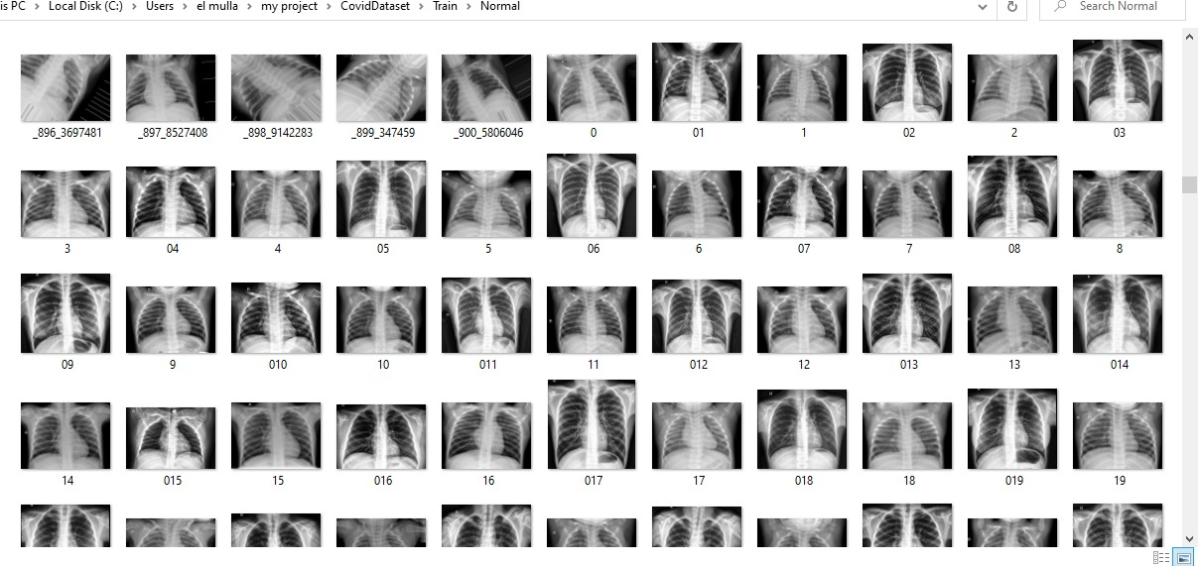
Deep Learning
The Amount of dataset was (10000) cases From Kaggle.
we use 70% from whole dataset for training & 30% for validation.
We get accuracy validation(86%) and accuracy Training (94%).

Slide 31
Import Chest X-ray from firebase

Slide 32
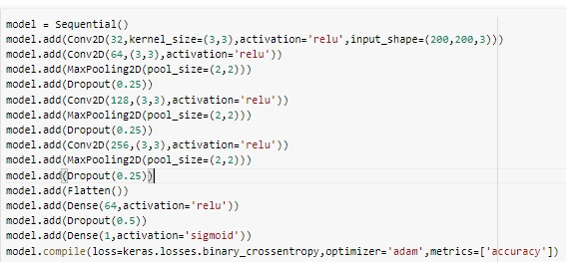
Build CNN model

Slide 33
Machine Learning Model

Slide 34
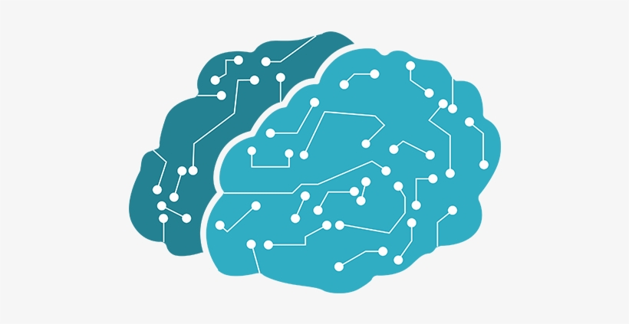
Machine Learning
Operate on the laboratory findings to make classification model.
this Classification is binary.
The model use SVM Model.
We use SVM Model from Sky-learn Library .

Slide 35
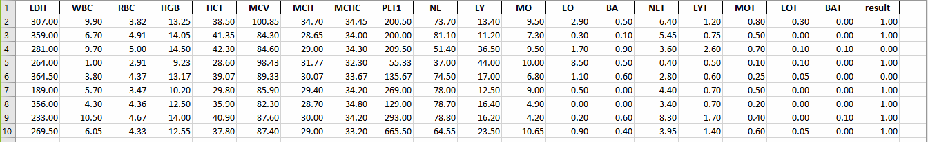
Machine Learning
The Amount of dataset was (1500) cases From GitHub.
we use 72% from whole dataset for training & 28% for validation.
We get accuracy validation(84%) and accuracy Training (89%).

Slide 36
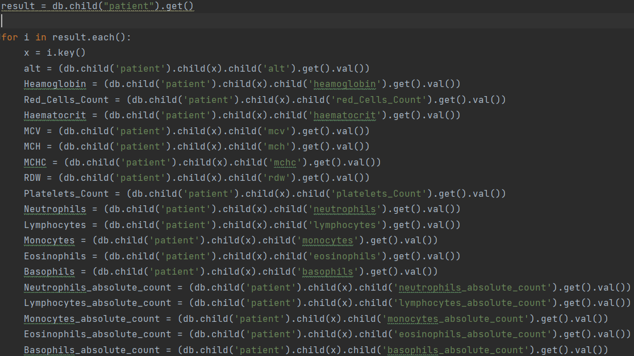
Import laboratory findings from firebase

Slide 37
SVM model

Slide 38
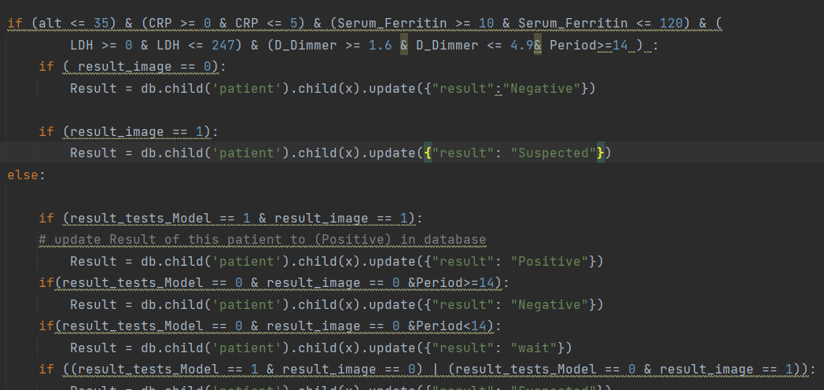
Model result

Slide 39
Desktop Application

Slide 40

Our Desktop app responsible for
Helping the doctor access the patient’s data recorded through android app.
Ensuring the possibility of infection by the disease or not.
Saving time and protecting him from infection by contacting with suspected people.
Sending an appropriate interpretation for all cases.

Slide 41

Desktop application
The design of the desktop application is implemented using Qt5 designer by drag & drop items of application
When using PyCharm interpreter to open Qt form it opens as XML code, then converts XML to python language by using tool (PYUIC5)

Slide 42
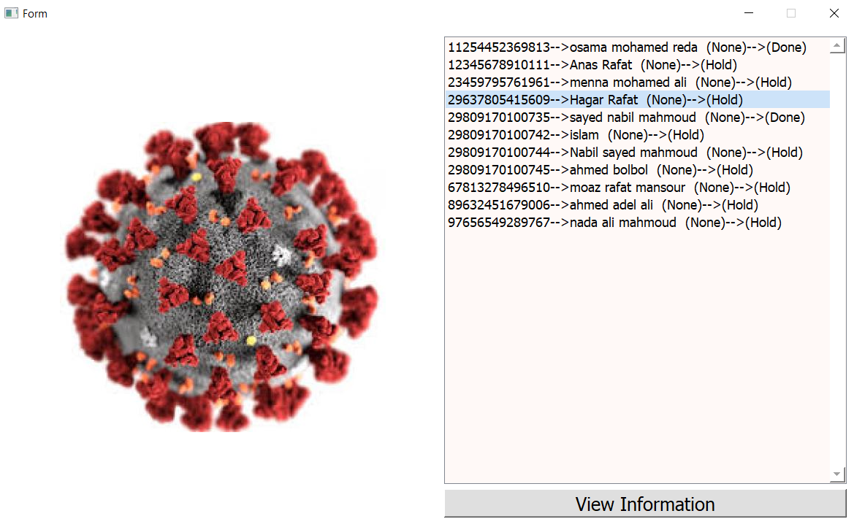
How Doctors apply to Desktop application?

Slide 43
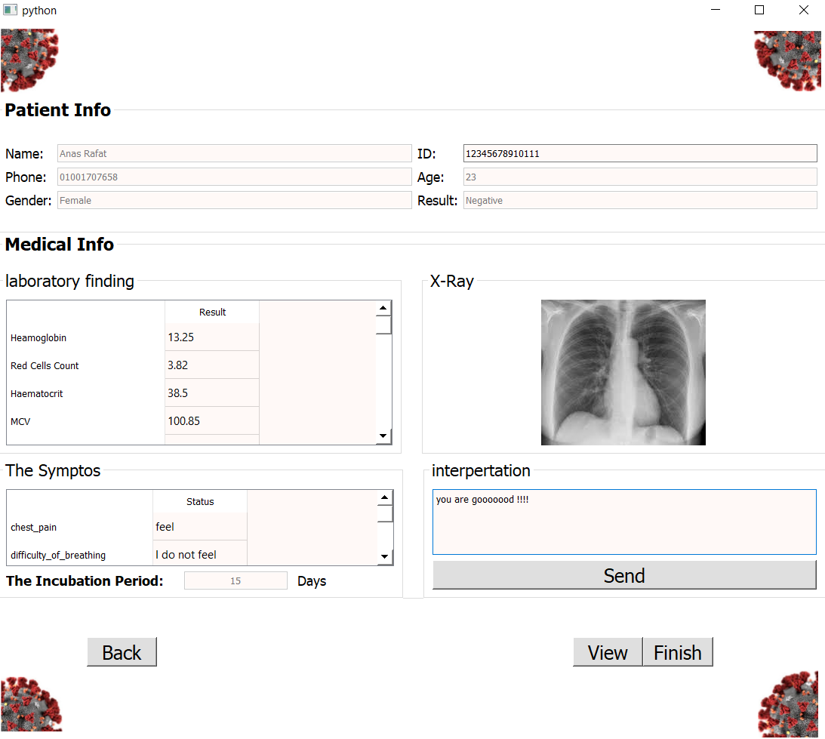
How Doctors apply to Desktop application?

Slide 44
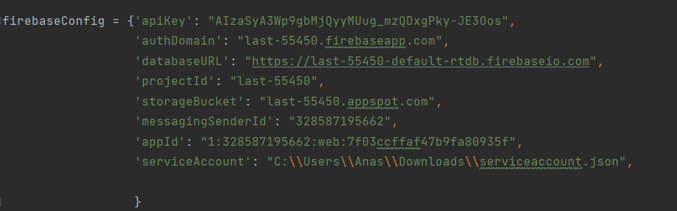
Connect Desktop App with Firebase

Slide 45
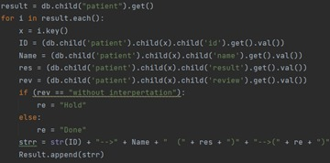
Connect Desktop App with Firebase

Slide 46
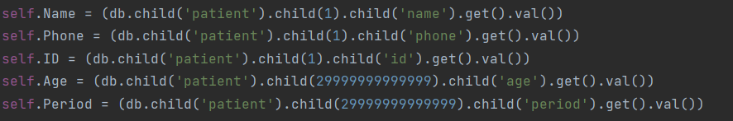
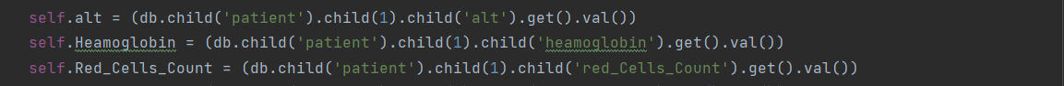
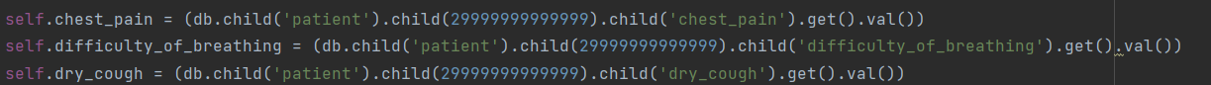
Connect Desktop App with Firebase

Slide 47
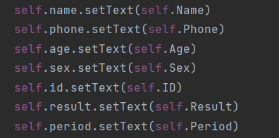
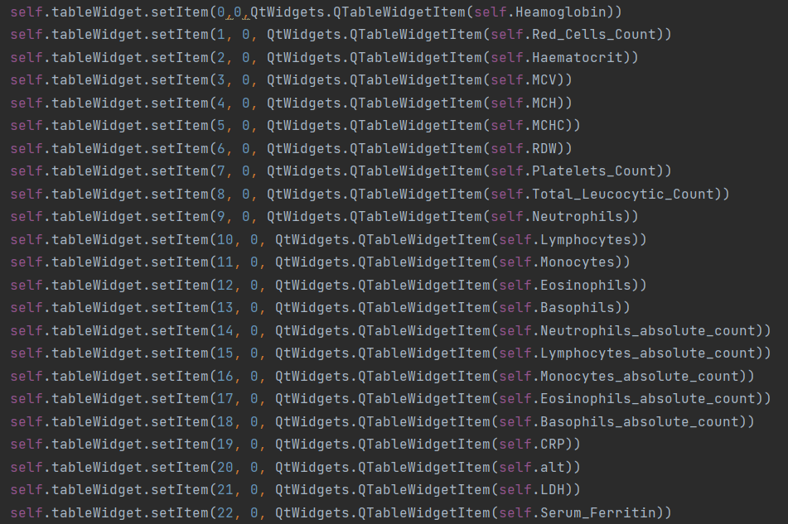
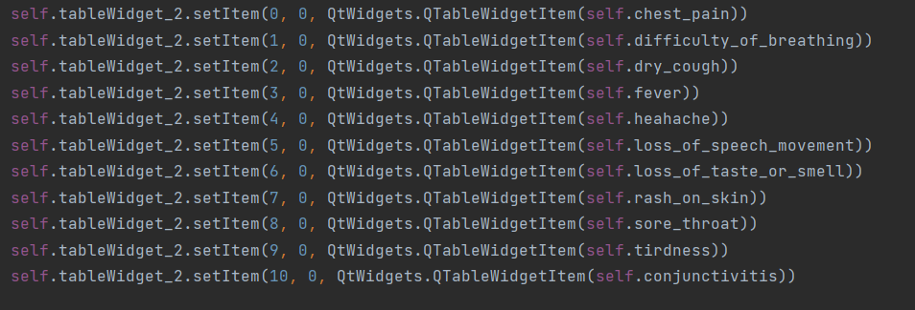
Connect Desktop App with Firebase

Slide 48
Connect Desktop App with Firebase

Slide 49
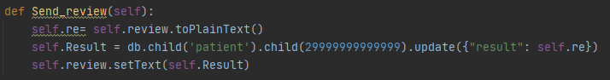
Connect Desktop App with Firebase

Slide 50
04
Problems that we faced

Slide 51
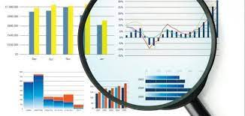
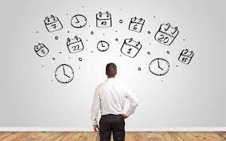
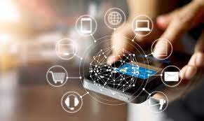
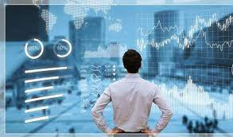
The problems that we faced.
difficult access to previous patient’s dataset.
Connection between
several platforms.
shortage of time
Reach to efficient accuracy of the model.

Slide 52
05
System Development

Slide 53




System Development
Make an electronic payment system.
Add chat connect between doctor and patient.
Use new patient’s data as extra dataset.
Increase dataset and edit model based on it for more accuracy.
Connect our system to full system of all medical plans to use patient’s data for helping in diseases and other medical diagnoses

Slide 55
Thanks

